Slide 1



UNIT 3: School
I love my school

Slide 2
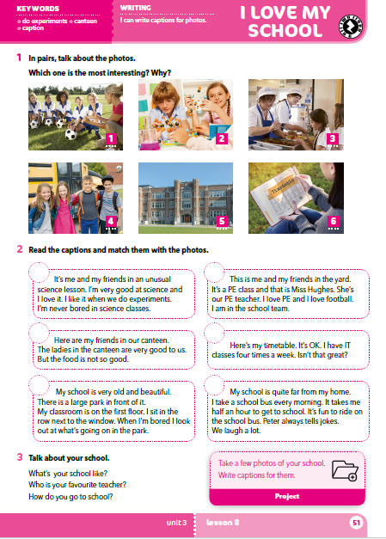
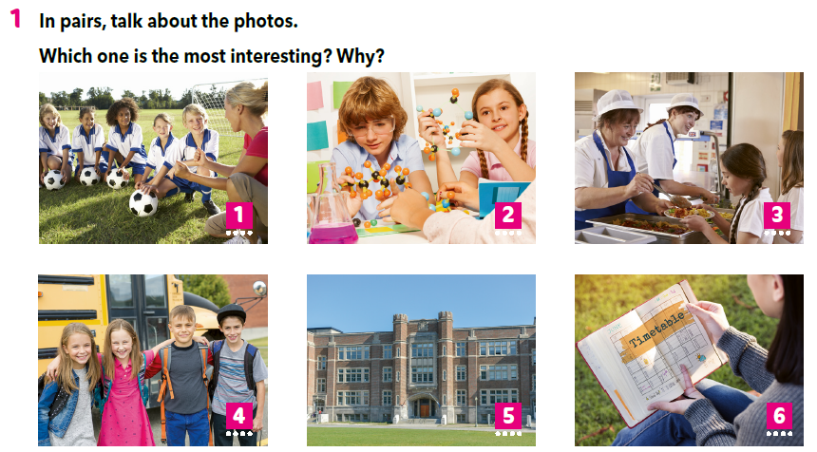

Slide 4
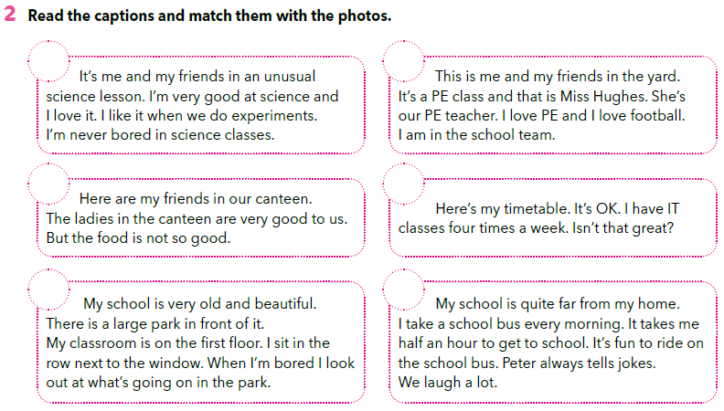
2
1
3
6
5
4

Slide 5

What’s your school like?
In which way is your school similar to this one?
How is your school different?
Who is your favourite teacher?
How do you go to school?

Slide 6
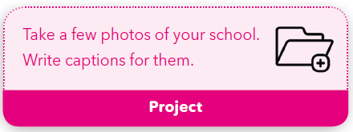
PROJECT TIME
Slikaj mobitelom ili tabletom ono što ti se čini važno za školu. Napiši opis za svaku sliku. Koristeći slike i opise složi prezentaciju o školi.

Slide 7
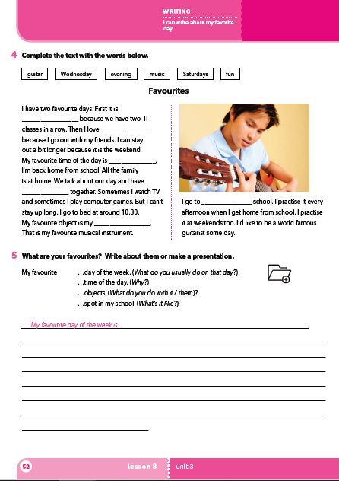
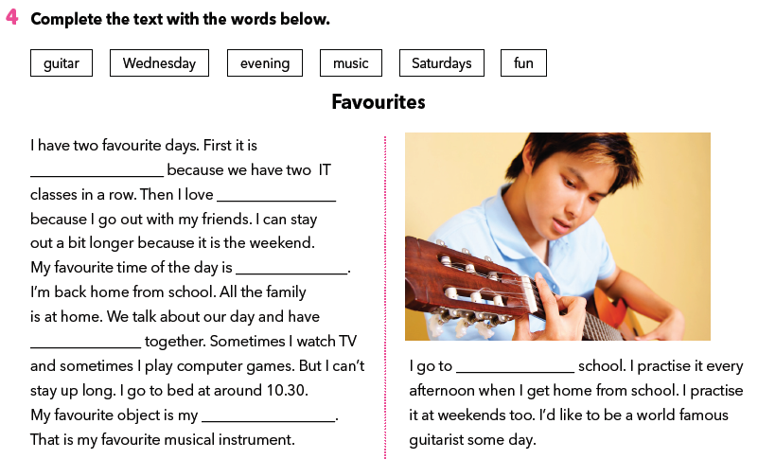
Workbook p 52.
Wednesday
Saturdays
evening
fun
music
guitar

Slide 8
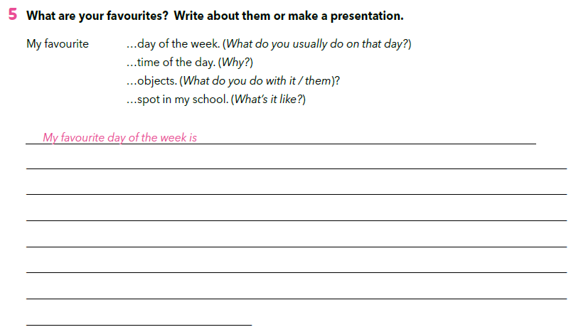
Moj omiljeni

Slide 9

SELF CHECK
https://www.e-sfera.hr/dodatni-digitalni-sadrzaji/145a1640-a1c2-4a06-9baf-8e26769cc424/

Slide 10
LEARN MORE
https://www.e-sfera.hr/dodatni-digitalni-sadrzaji/145a1640-a1c2-4a06-9baf-8e26769cc424/
My dance school

